Slide 1
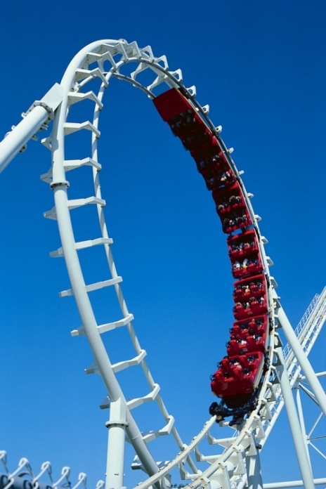
Trainer Introductions
Olivia Newton
Mark Pash

Slide 2
Welcome
Olivia Newton
8:00am – 5:00pm ET
Email address: olivia.newton@havefun.com

Slide 3
Welcome
Mark Pash
6:00pm – 2:00am ET
Email address: mark.pash@havefun.com

Slide 4
Next Steps
Review the Summary
Begin your Workplace Safety Training
Access EctoLearning
Join the group – Have Fun Workplace Safety Training

